Slide 1
THE EVOLUTIONARY ROOTS OF OUR ENVIRONMENTAL PROBLEMS: TOWARDS A DARWINIAN ECOLOGY Dustin J. Penn Konrad Lorenz Institute of Comparative Ethology
By Shilajit Banerjee

Slide 2
What is all about this paper?
Environmental problems are quiet visible these days which often is ignored by us. According to the author of this paper he finds some interesting evidences about us being the main reason of these ecological changes rather destruction.
The author has also emphasized on the overview of how evolutionary research can help to understand why humans are ecologically destructive.
Evolutionary analysis of human behaviour offers practical implications for environmental policy, education and activism.

Slide 3
Let’s talk about some Statistics
Humans or ‘Homo Sapiens’ took a long time to reach population of 10 million.
Now we are adding 10 million every six weeks which quiet astonishing if we think.
Global population now is around 8 billion (2022) and it might reach 11 to 12 billion in next few years.
After looking at these facts we should ask ourselves a question whether our planet will be able to sustain this huge amount ‘Homo Sapiens’ because according to the data we consume 40% of the food available 45% of the sweet water available. So, what about the other animals or the earth only belongs to us?

Slide 4
Some more facts
Humanity has become a geological force and our pollution of the atmosphere is altering the climate of the Earth.
We have become the main reason of mass extinction of thousands of species vanishing each and every year.
By destroying our planet’s natural resources, biodiversity, and ecosystem ser- vices, we are weakening its capacity to support our ever growing populations, and subsequently creating violent conflicts and health, social, and economic problems for ourselves and future generations.

Slide 5
Warning!
Some people argue that this problem is not due to overpopulation. According to them the main cause is overconsumption. So, industrialized countries consume the vast majority of the Earth’s resources. Hence Scientists have given a firm warning to the developed nations to reduce their consumptions.
Here we face a dilemma: Wealthy countries want poor countries to reduce their population and poor countries want wealthy countries to reduce their consumption. So, we arrive at Population-Consumption trade off.

Slide 6
Human Behaviour and Environmental Problems
Evolutionary psychology suggests that human behavior is shaped by the process of natural selection. This means that certain traits and behaviors that were advantageous for survival and reproduction in our ancestors became more prevalent in the population over time. In the case of discounting the needs of future generations, it is possible that this behavior evolved because it was beneficial for our ancestors to prioritize their immediate needs over long-term considerations. In an environment where resources were less and competition was fierce, individuals who prioritized short-term gains were more likely to survive and reproduce.

Slide 7
Evolutionary Biology
It basically provides the basic insights into human behaviour including reproduction, politics, ethics and morality.
Evolutionary approaches have much to say about human culture. For example, social learning evolves by natural selection and generates novel behaviors that can potentially create new sources of genetic selection.
The evolutionary approach to understanding human behavior is often ignored or rejected by environmental scholars, partly because of a lack of awareness about recent advances in the social sciences that integrate evolution into the study of human behavior. Additionally, there is a misunderstanding of "human nature" as a constraint rather than an enabling factor for change and adaptation, which can be seen as an obstacle to environmental efforts.

Slide 8
Darwinism and Misunderstanding
The concept of Darwinism is often misunderstood as being useful only for explaining and justifying individualistic selfish behavior, social inequality, and political goals of the conservative right. This misconception is one of the reasons why it is viewed as an obstacle to change.
However, the theory of evolution by natural selection is not limited to individualistic, selfish behavior. It also encompasses cooperative behaviors, which are equally important for survival and adaptation.
Cooperation has played a crucial role in human evolution and understanding it can help solve social and environmental problems.
Darwinism provides a comprehensive view of human behavior that is not aligned with any political ideology, and can offer insights into addressing current issues.

Slide 9
The Ecological Noble Savage Hypothesis
The belief among some environmental scholars that the root cause of human ecological destruction can be traced to the cultural and ideological values of the West, particularly its emphasis on human domination and control over nature. According to this view, Western societies have adopted an anthropocentric and scientific worldview that has led to the exploitation and degradation of the natural world.
As a response to this problem, some environmentalists argue that we should reject the materialism and reductionism of science and instead adopt the animistic and spiritual beliefs of non-Western religions and traditional cultures, which tend to view humans as part of a larger ecological system.
Others argue that it is impractical and unrealistic to reject science and embrace spiritual beliefs in the modern world. Instead, they advocate for a more nuanced and inclusive approach that recognizes the value of traditional knowledge while also embracing scientific and technological solutions to environmental problems.

Slide 10
Author’s Point of View
It is a myth that humans lived in harmony with nature until the spread of "Western" culture. The author argues that evidence shows that humans have a history of ecological destruction, indicating that environmentalists have valid reasons to be concerned about the potential for ecological destruction caused by humans. Additionally, the author suggests that achieving ecological sustainability may be more challenging than previously thought and that rejecting Western science and embracing mysticism is not the solution. Instead, the author suggests that we can learn from successful resource management strategies used by different societies and apply this knowledge to design adaptive strategies for addressing ecological problems.

Slide 11
Evolutionary Perspectives on Environmental Problems

Slide 12
Stabilizing Population Growth
Human population is one of the major reasons for which our Earth is suffering ecological problems. So, stabilizing the population growth is a great challenge.
Before making efforts to stabilize the population growth we should understand first why fertility has declined in some societies.
The idea behind demographic transition theory is that fertility decline implies improved survival chances. If mortality rate is very high (20-30 years avg) then 5 or more birth per woman is required to continuation of the species.
However we cannot count on people to reduce their reproduction for common good.
Researchers are applying principles of evolutionary biology towards understanding the fertility including fertility transitions.
Have we ever wondered why people from wealthy country do not use their wealth to make more off-springs. Why do they have lowest fertility? This question was sparked by Daniel Vining (1986).

Slide 13
Continued…
The reason is that people in developed country are trading offspring quantity for quality. People in developed countries has fewer off-spring because they require more investment to make their off-spring competitive. There can be many more reasons such as – when wealth is inherited the rich may have advantage by producing few but well provisioned off-spring and sometimes people copy fertility behaviour from the society.
Modern fertility declines may be due to exposure to evolutionary novel chemical pollutants in the environment which are reducing the sperm count.
Some environmentalists distrust evolutionary biology due to past instances of social elites using it to justify population control measures targeting poor and non-white populations.
The author emphasizes that evolutionary biology can provide insights into human behavior, but it does not offer a moral justification for harmful actions.
Furthermore, the author points out that biologists have traditionally focused more on population growth in poor countries, while neglecting overconsumption in wealthy countries. However, this is changing as more research is being conducted on the topic.

Slide 14
Reducing Consumptions
Industrialized nations and their inhabitants, particularly humans, utilize a significant amount of the Earth's natural resources. To illustrate, Americans make up only 5% of the global population but consume 25% of the world's resources, release 20% of the carbon dioxide emissions that contribute to global climate change, and generate almost half of the hazardous waste produced on the planet.
Obesity and diabetes have become major epidemics in the United States due to the high consumption of calories from fats and sugars.
The evolutionary explanation for overeating is that our ancestors were naturally inclined to crave these types of foods because they were difficult to obtain. However, modern fast foods satisfy these cravings without the energetic costs of hunting and processing the food.
Our impact on the environment, however, is not just from overconsuming food and other resources needed for survival, but rather from the pursuit of excessive consumption.

Slide 15
Continued…
Charles Darwin proposed that animals develop conspicuous and extravagant traits, such as the peacock's elaborate plumage, to attract mates and repel rivals. This evolution occurs through differential mating success or "sexual selection.“
Evolutionary researchers are beginning to give importance Veblen's ideas about conspicuous consumption. Their studies support the idea that conspicuous displays of wealth enhance social status and mating success.
People in nearly all human cultures (especially women) prefer mates with high status and good resources or prospects, and conspicuous displays of resources are used to signal high status and increase mating success.
Research indicates that, despite increases in absolute wealth and consumption, people's happiness does not necessarily increase beyond a certain point. Instead, it is relative wealth that holds more significance to individuals, as shown by various studies (During 1995).
Once people's immediate survival concerns are satisfied, their preoccupation with social status and other "positional goods" appears to intensify.

Slide 16
Discounting The Future
Our environmental issues can be attributed to the fact that humans tend to prioritize immediate, fleeting pleasures over the more significant needs of the future.
Temporal discounting is viewed by evolutionary theory as an adaptation that improves an individual's survival and reproductive success.
Squirrels that focus excessively on preparing and storing food for the winter, instead of addressing their immediate survival needs (such as watching out for predators), have a lower chance of surviving the winter. Additionally, discounting the future makes sense because individuals always face uncertainty about whether potential future benefits will actually be realized.
Evolutionary theory suggests that men tend to place a lower value on future outcomes compared to women due to various factors such as men having a shorter life expectancy than women and allocating resources to compete for and attract mates.
By adopting an evolutionary perspective, we can gain insight into why humans have a tendency to prioritize short-term gains over long-term benefits, as well as why our species has a history of causing ecological problems. If the human mind is shaped by evolution to devalue the future, then policies that ignore this aspect of human psychology are likely to be ineffective. There is still a lot we need to discover about the factors that influence people's long-term orientation.

Slide 17
The Tragedy of the Commons
"The tragedy of the commons" has become a critical concept for comprehending our ecological issues. It explains why people have a tendency to overuse shared resources such as public grazing lands, fisheries, and aquifers, and why they contaminate them.
Every person confronts a dilemma in which they question themselves, "Why should I reduce my reproduction and environmental impact if others are not willing to do the same?" Garrett Hardin, an evolutionary ecologist, first proposed the tragedy of the commons as a broad explanation for the overuse of ecological resources.
Environmentalists have criticized the tragedy of the commons model ever since Hardin proposed it. However, much of this opposition was caused by semantic misunderstandings. In his original paper, Hardin used "common-pool resources" to refer to resources that are collectively owned. Hardin highlighted that the debate could have been prevented if he had titled his paper "The Tragedy of the Unmanaged Commons".
The tragedy of the commons is not an unavoidable phenomenon, and the model proposes that people's behavior towards natural resources is influenced by social conditions. However, additional research is necessary to determine whether social pressure can help prevent the tragedy of the commons in real-life ecological and social settings, rather than just in controlled laboratory experiments.

Slide 18
MALADAPTIVE BEHAVIOR
It is unfortunate that individuals are not more worried about environmental dangers, such as toxic chemical pollutants that can harm their well-being.
Cognitive researchers have been surprised as to why individuals struggle to assess environmental risks and probabilistic questions. Despite being highly skilled at solving complex problems, such as speech perception and facial/object recognition, humans often fail at simpler tasks like risk evaluation. However, this is not due to the brain being flawed in design, as commonly believed. Evolutionary psychologists have found that reframing or representing the problem in a more natural ecological context can improve risk assessment.
To address environmental problems, we must alter our perception of these threats. Industries have to show the level of harmful emissions, even if invisible, and authorities should take of this. By integrating evolutionary and cognitive perspectives, many possibilities can be explored to tackle these issues, making it a fruitful area for future research.

Slide 19
ENVIRONMENTAL ASTHETICS
We may be ecologically destructive but we almost all cherish nature and it’s beauty. We visit beautiful places, zoos, jungles etc.
Research shows that people love taking photos in nature rather than an artificial condition because our natural environmental preferences may not develop "normally" in artificial settings like modern cities.
Evolutionary research can help explain why people are environmentally destructive or become environmental advocates. By understanding the constraints and possibilities of human behavior, we can find practical solutions for addressing ecological problems.

Slide 20
Environmental Policy from an Evolutionary Perspective
Environmentalists believe that reducing our ecological impact requires a reduction of population growth and consumption. However, it's unclear how we can create the changes needed to accomplish these goals. Legal limits on family size and consumption or taxation may be necessary, but we still need public support to enforce such policies. Understanding human nature better can lead to more effective solutions. Environmental education, policy, and activism can all benefit from an evolutionary perspective.

Slide 21
Environmental Education
Education can bring change and address environmental problems. We also cannot expect people to sacrifice their short time interests for long term good of the planet.
But can education bring change really? Researchers are saying that education can only bring change to simple behaviour like depositing the can.
But education is still necessary for the first step but it is definitely not sufficient.

Slide 22
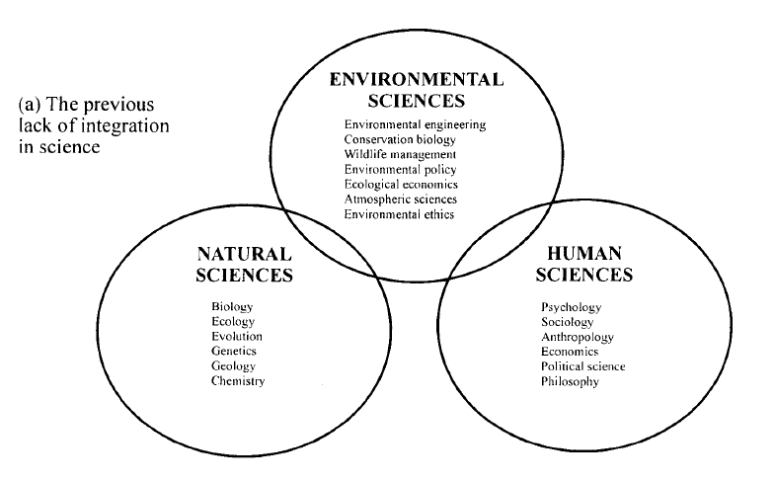
Conclusion

Slide 23
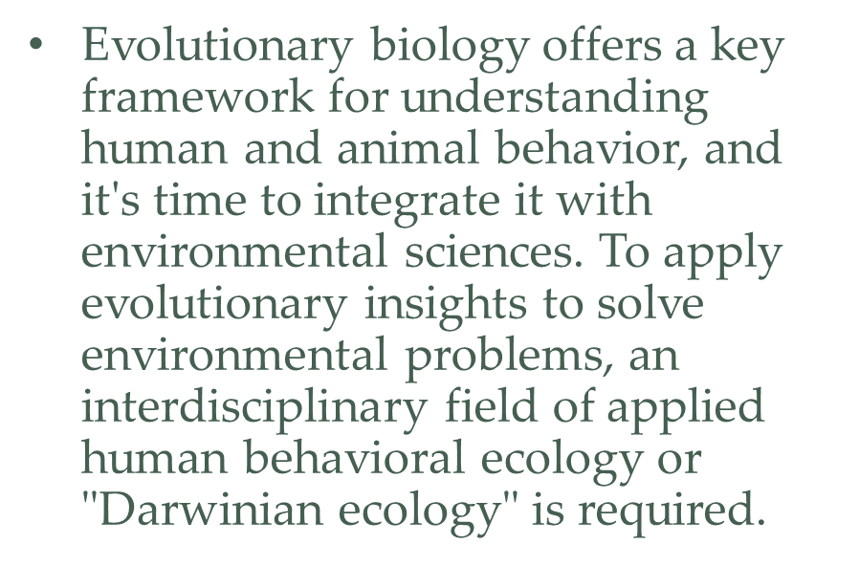
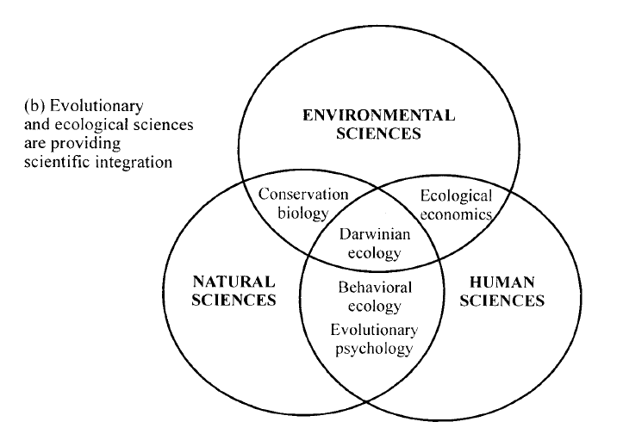
Conclusion

Slide 24
Thank You!

